Slide 1
Adopting Angular2 as an accelerator for new UI development – an LDNG journey
Vishnu Palaniswamy
Dan Liu

Slide 2
Agenda
Problem statement – why did we need to start looking for a new UI development framework?
Technology selection process – how and why did we pick Angular2?
Angular2 adoption – how did we incorporate Angular2 into our application and our development processes?
Takeaways and benefits – how did using Angular2 help our project timelines and our staff development?
Questions and Some Answers?

Slide 3
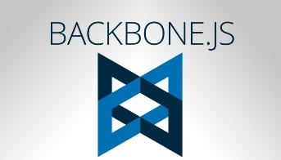
About the New Loan Delivery (LDNG) Web Application
Single Page Application built with Backbone JS and Marionette JS
39* total screens and modal windows
52K lines of code
8 JavaScript developers worked on it from April 2014 through October 2015
Backbone JS was selected as the UI “library” at the time -
It’s a library, not a framework
Provides Model, Collection and View
Marionette JS adds framework like features, reduces boiler-plate code
One-way binding only
No declarative forms support
* inclusive of various roles and views

Slide 4
Why was there a pressing need for technology change?
Program and Personnel Challenges
Due to program delivery commitments, LDNG had significant hiring needs (21 developers were hired in 2016)
Developers with Backbone JS experience became increasingly scarce in the market
Backbone JS itself had decreased in community activity and enterprise adoption overall
Out of 120+ candidates screened, less than 5 had Backbone JS listed on their resumes
Technology Challenges
Steep learning curve for existing developers, especially those coming from a Java background
Needed a sustainable platform for the future
The new Loan Certification program was to start soon

Slide 5
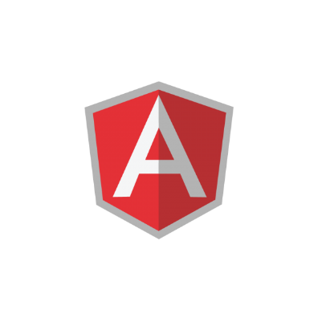
Why Angular? (Angular 2)
Framework | Language | Ecosystem
A “full” framework à la Spring Moves more responsibility from the developer into the framework Two-way binding with change detection is big benefit (but, beware) Angular 2 is substantially different from Angular 1.x and we did not want to start with a ‘legacy’ framework and go through an upgrade later. Convention based and prescribes an application structure and other aspects - Angular Style Guide Testability, test harness, and the Command-Line Interface (CLI) Less custom-coding Less boilerplate code | TypeScript brings in object-oriented JavaScript. Java developers will pickup faster. Stackoverflow’s 2017 global developer survey listed TypeScript as the 3rd most loved language! Easier-to-learn for non-UI developers Object-oriented concept allows for type-safety TypeScript can be transpiled into ES5 or ES6 compliant browsers | Community adoption is skyrocketing - Growing eco-system – Angular Summit is mostly focused on Angular 2 at this point Google Trends show growing overall interest Pace of enhancements and releases by Angular.io is fast
Notes:
Action Item – provide links to YouTube videos, Udemy course(s), and Safari book(s) if available
Recommend that we go over this content as how we made a decision, not on what Angular2 does

Slide 6
Execution
New Loan Delivery functionality (Baliee and ASAP Plus) will be developed with Angular 2
Look and Feel will be the same(ish)
Loan Certification platform developed with Angular 2
Demo of two screens and features
Metrics comparison of development time/effort/complexity – and richness of features
Direct program timeline benefit

Slide 7
Testability Code coverage – 80%

Slide 8
Questions and hopefully we have some answers!

